Slide 1
ANIMATION and SIMULATION TOOL for DIAGRAMS
Group 02
Boyan Dai, Erik Laurin, Elaine Qvarnström, Joacim Eberlen, Justinas Stirbys, Shaun McMurray

Slide 2
What was planned:
What was accomplished:
Come up with a project idea
Establish a working process
Make a product backlog
Design initial architecture
Got a viable project idea
Working process established
Established a social contract
Began working on architecture and product backlog
Made a project plan
Branch model

Slide 3

Next Sprint
Complete architecture and product backlog
Establish requirements
MVP

Slide 4
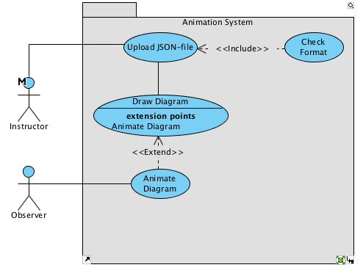
Areas of Improvement
More efficient meetings
Distribute workload
Spend more hours on the project
Work at home
Minimal Viable Product

